Slide 1
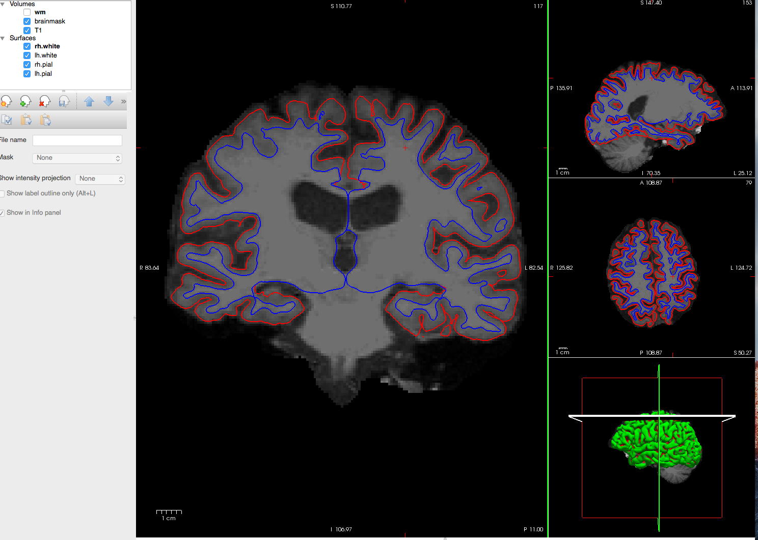
WM error here
WM error
WM error

Slide 2
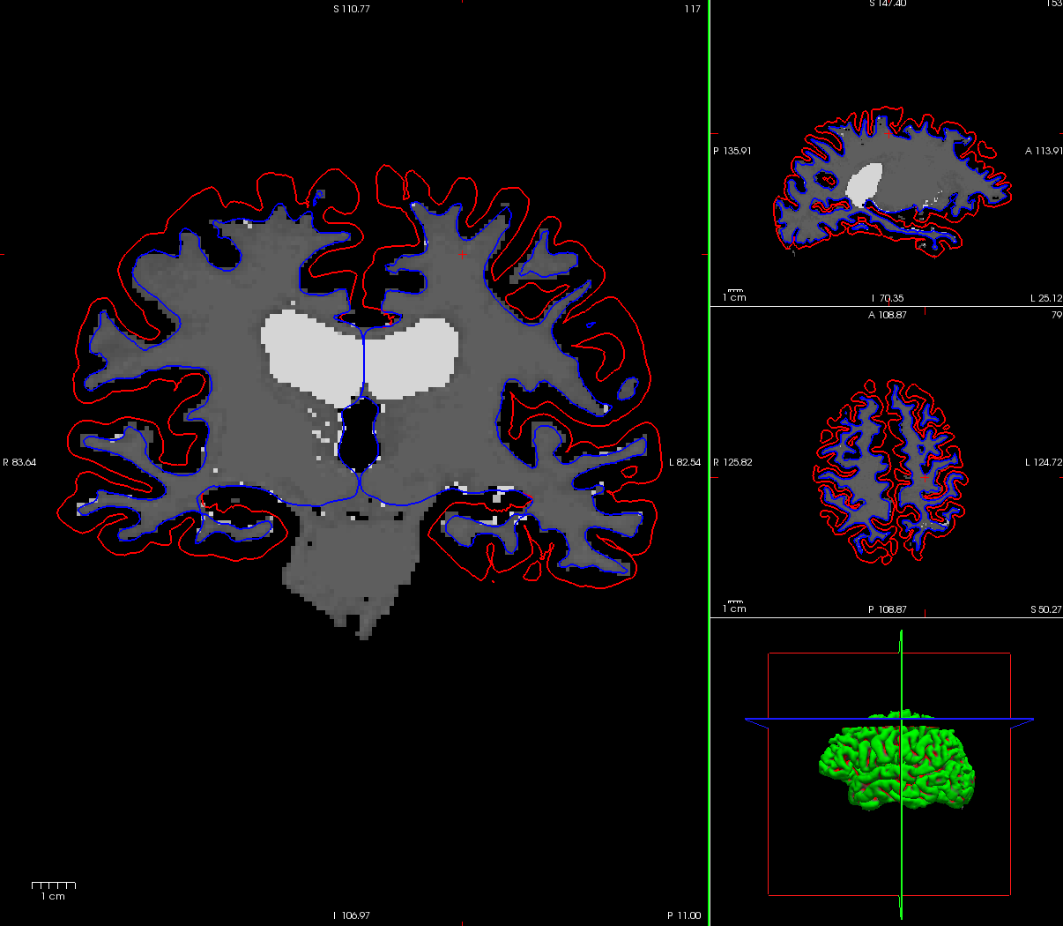
In the WM surface and pial surface, you can see the wm does not extend as
far as it should into the cortex. This is a frequent error for our sample.

Slide 3
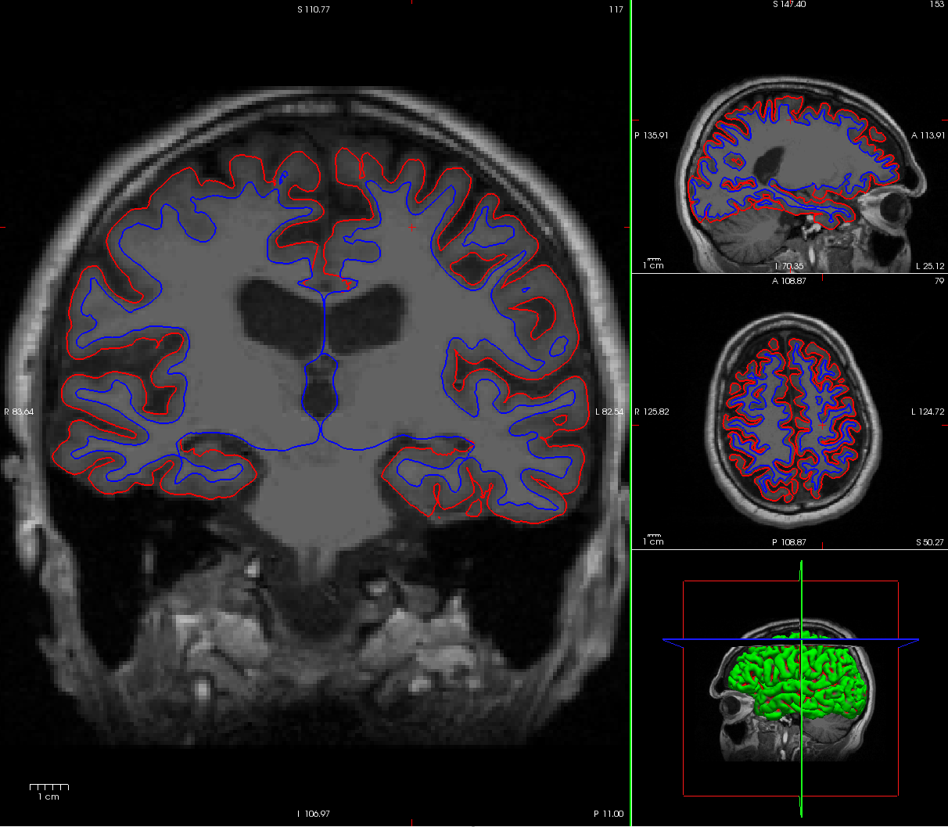
This is the same brain’s T1 image with the white matter surfaces.

