Slide 1
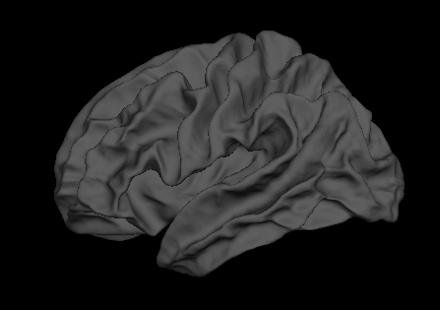
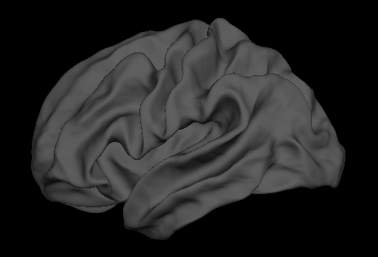
White surface
fsaverage
My template “from scratch”
80 subjects

