Slide 1
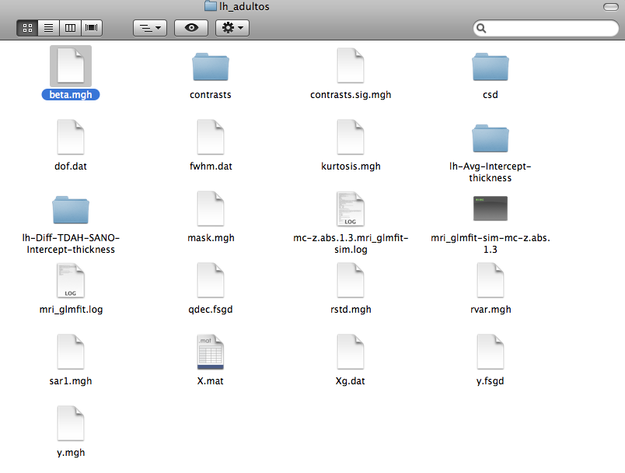
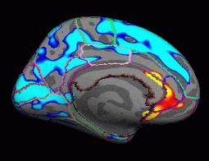
I want to obtain the uncorrected significance map for the GLM Analysis (mri_glmfit), but it seems the command sequence for tksurfer view didn’t work with my glmdir. I obtained a group of directories and files after I realized the glmdir process, they are very similar to the ones you described in the tutorial (Figure 1). I need to know which changes I have to do in the command secuence for the tksurfer view of the uncorrected significance map.
Besides, I would like to obtain a similar map which includes only the color limits of every Brodmann area (NOT the thickness color areas). Or I should use other method to obtain it? (Figure 2)
Figure 1
I want these limits I don’t want these areas
Figure 2

